Slide 1


Slide 2

Introduction
Henk Oordt
Bachelor Computer Science at Hanzehogeschool Groningen
Pre-master embedded systems TUE (ongoing)
Joined TG early 2019
Rust since 2018, embedded since 2019

Slide 3
Part 1
Embedded Rust Workshop

Slide 4
Our day
Our morning is divided up into:
Introduction
Exploring the Rust embedded ecosystem
Exercise 1
Portable drivers in Rust
Exercise 2

Slide 5
Introduction
Who am I?
Dion Dokter
Bachelor’s Applied Computer Science at Saxion Enschede
Embedded Rust since 2019
Joined TG in 2021
LoRaWAN IoT
UWB Real Time Localization System

Slide 6

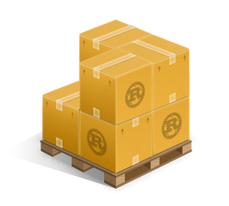



Exploring the Rust embedded ecosystem
Rust, C++, C
core, alloc, std
cargo, crates, rustc
probe-rs

Slide 7
Cortex-m crates
Cortex-m
Peripheral Access Crate
Similar to CMSIS register definitions
Cortex-m-rt
Startup runtime
Interrupt setup

Slide 8
Device PACs
Every device has different peripherals. One PAC for every device.
Generated from SVD
Imported as dependency

Slide 9
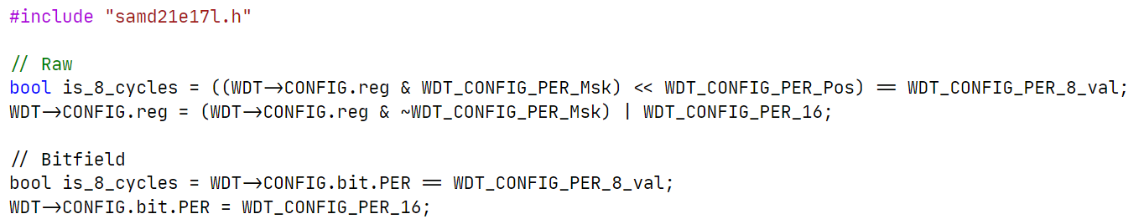
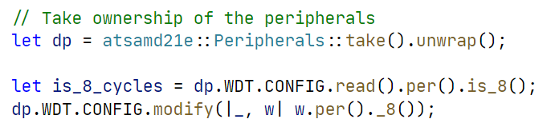
Device PACs
C
Rust

Slide 10
Device HALs
Many open source HALs
Most basic operations supported
Built on top of PACs

Slide 11
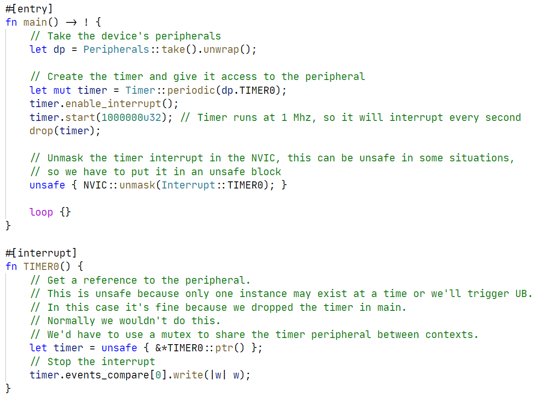
Device HALs

Slide 12
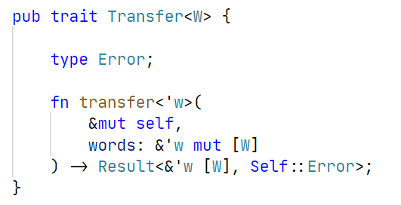
Embedded-hal
The glue of the entire ecosystem
Contains abstractions for many common operations
SPI example trait:

Slide 13
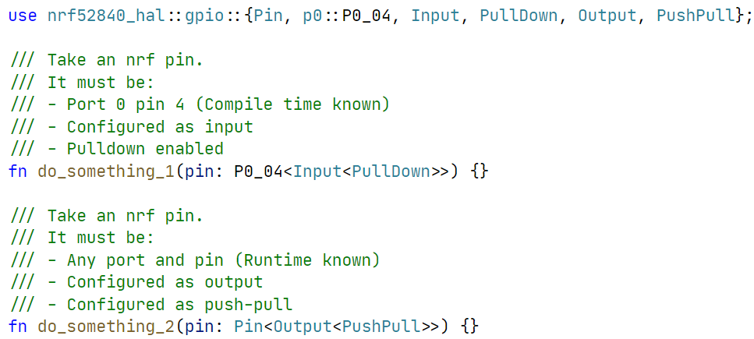
Typestate
State encoded in the type of the variable

Slide 14
Runtimes
Bare metal + interrupts
RTIC
(Real-Time Interrupt-driven Concurrency)
RTOS
Async

Slide 15
Questions so far?
?

Slide 16
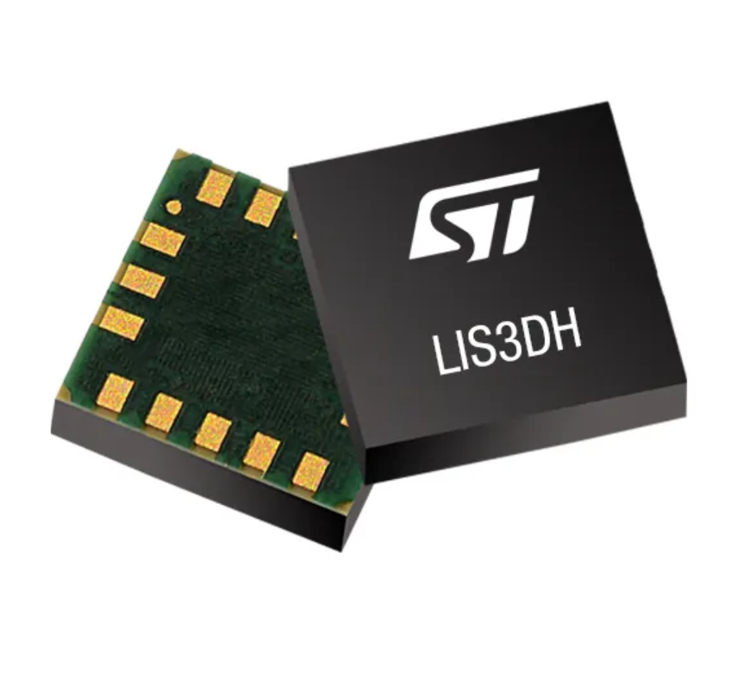
Exercise 1
Meet the LIS3DH
Clone the repository: https://github.com/tweedegolf/workshop-embedded-twoparter
Open your favorite text editor in ‘assignments/part_1’
Open the book and read the intructions
We are going to read the ID register of the chip

Slide 17
Solution
How did you solve it?
What were the problems you encountered?
What did you like or dislike?

Slide 18
Portable drivers
We want drivers for devices
We want them to be portable
Abstraction in C?
Abstraction in Rust?
Low level & high level drivers?
A low level driver
Possibilities in Rust

Slide 19
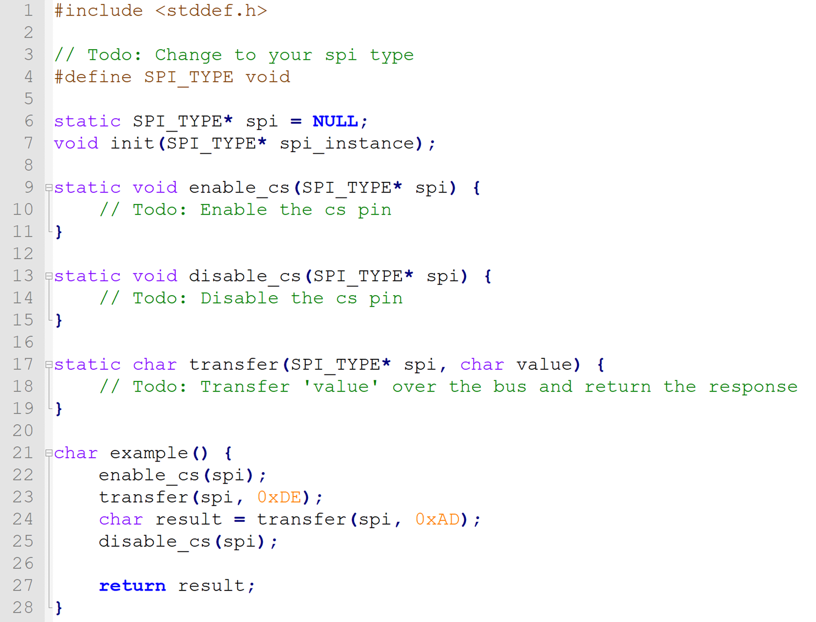
Abstraction in C
Fill-in functions
Efficient
Inconvenient

Slide 20
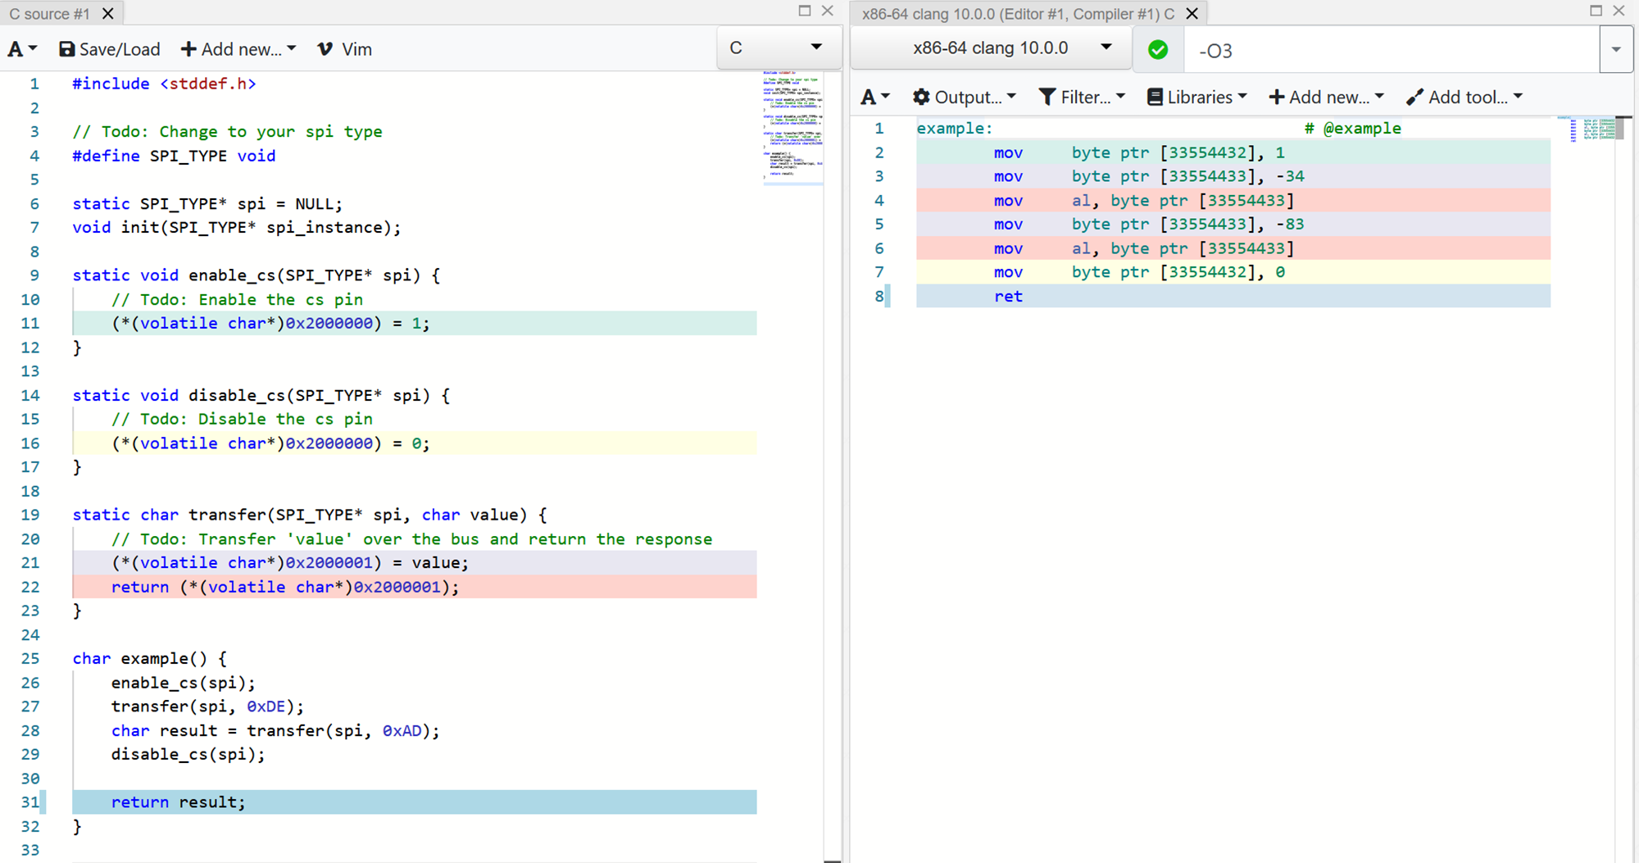

Slide 21
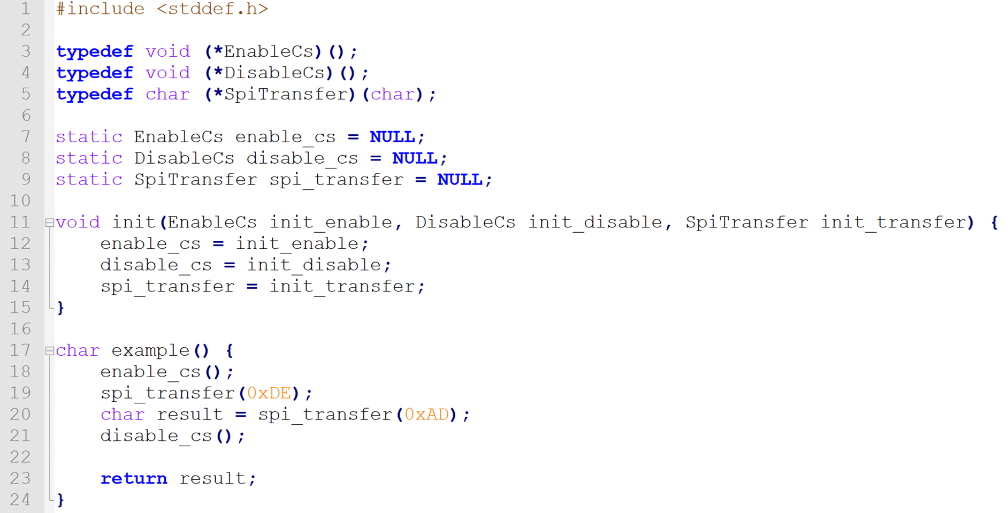
Abstraction in C
Function pointers
Inefficient
Convenient

Slide 22
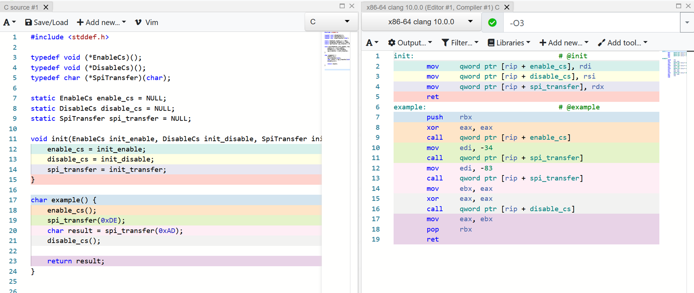

Slide 23
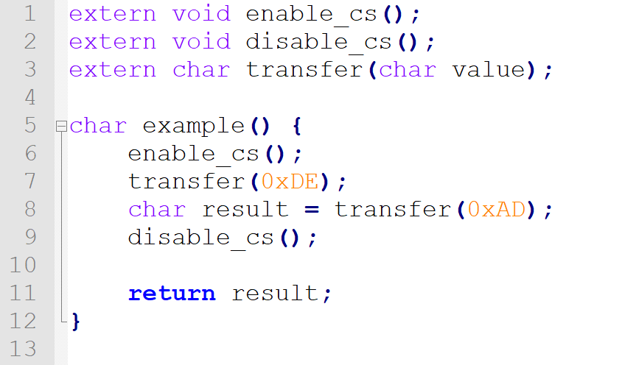
Abstraction in C
Link-time binding
Efficient
Somewhat convenient
Error-prone

Slide 24
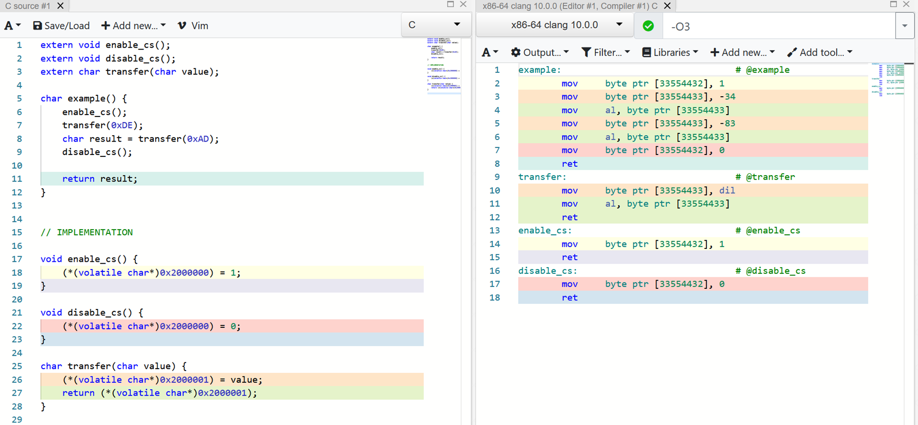

Slide 25
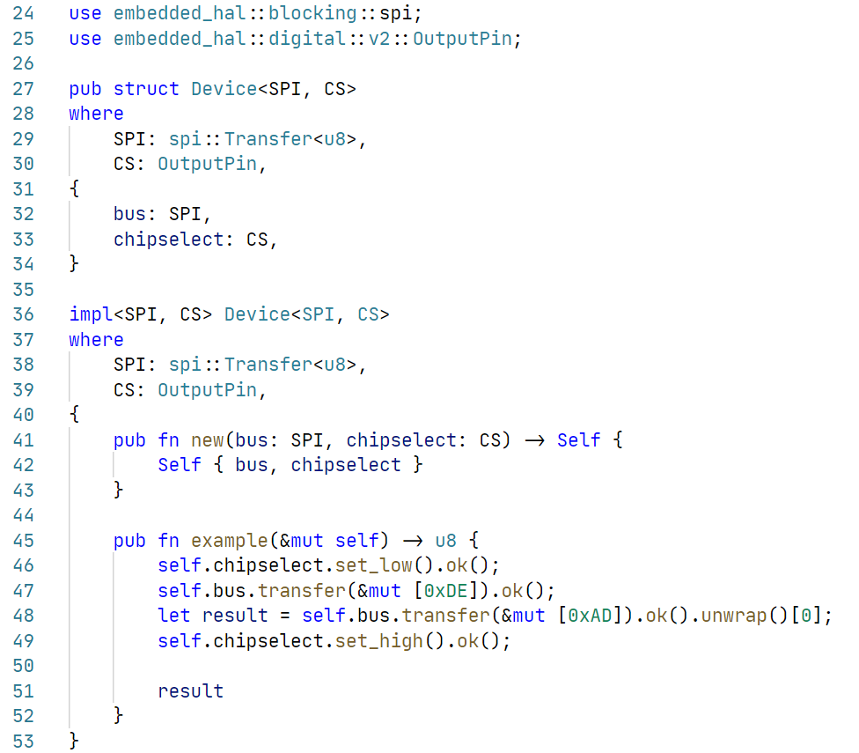
Abstraction in Rust
Traits + generics
Reuse traits from embedded-hal
Efficient
Convenient

Slide 26
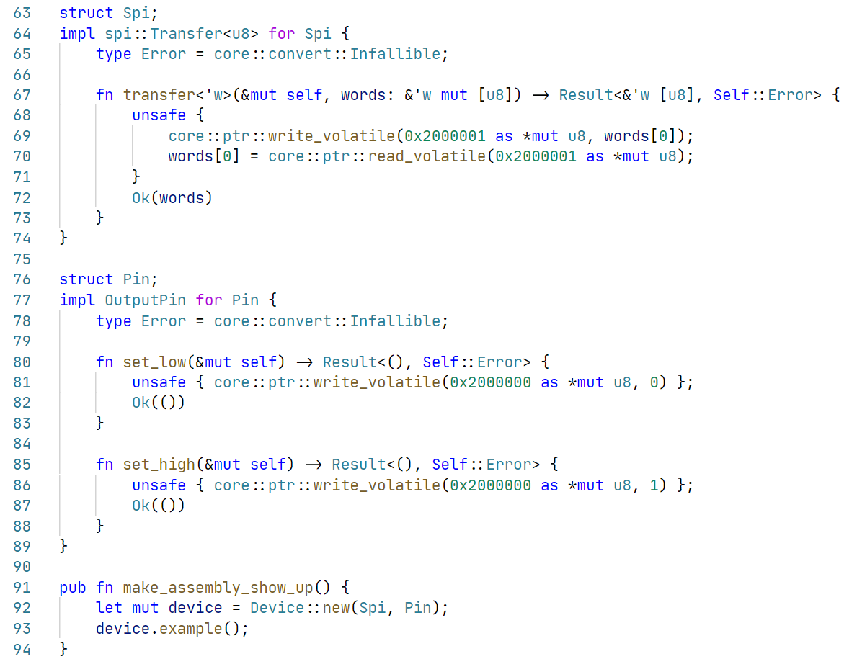
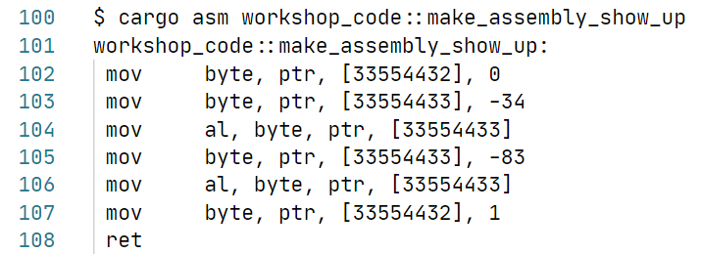

Slide 27
Low level & high level drivers
Low level driver
Hardware abstractions + reading/writing registers
Register/buffer/command definitions
High level driver
Implement common routines
Requirement assertions
Common interface export

Slide 28
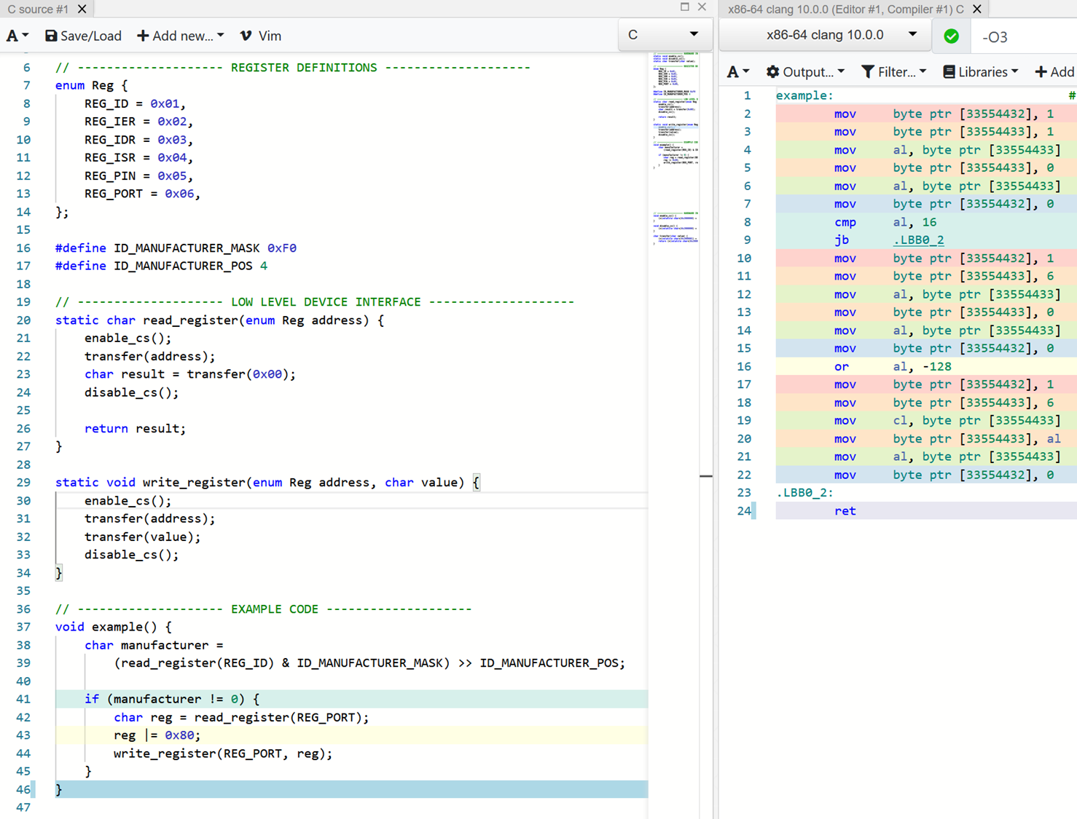
Low level driver in C
Enum & #define for definitions
Functions for read/write

Slide 29
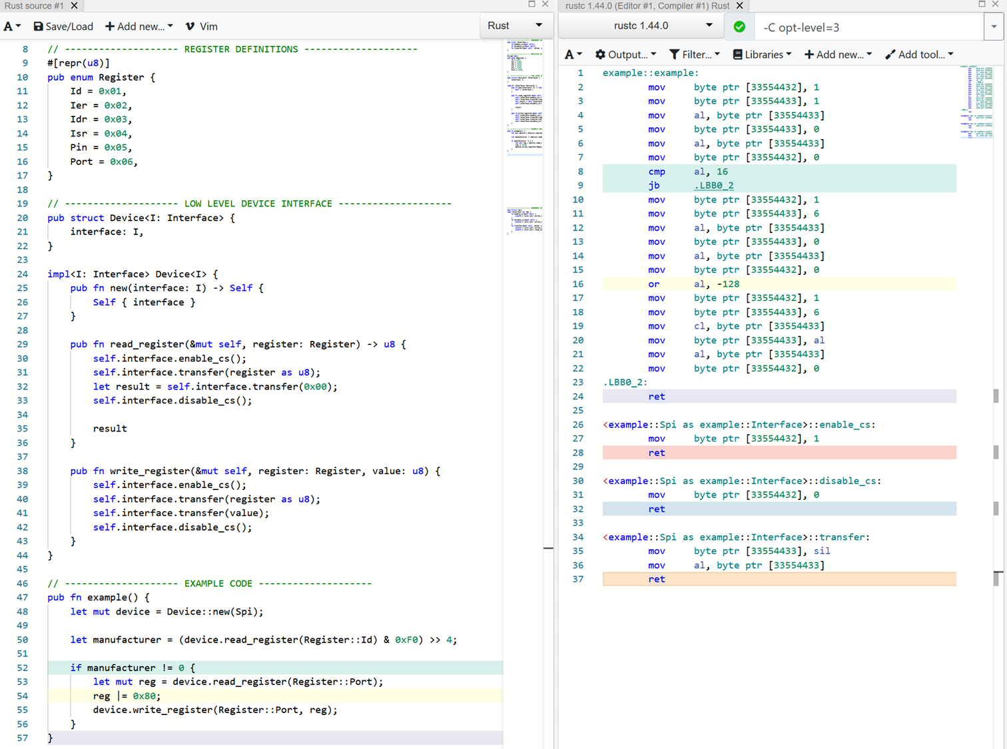
Low level driver in Rust
Enum for definitions
Device struct representing an instance of a chip
Functions for read/write

Slide 30
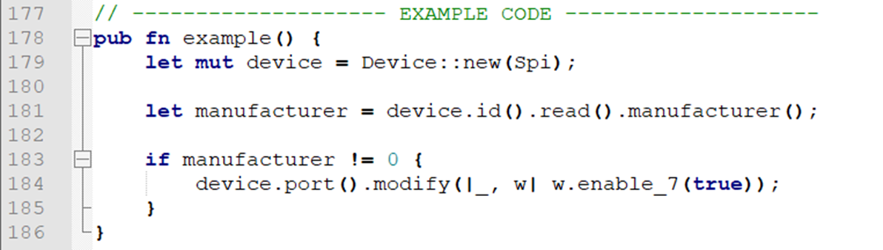
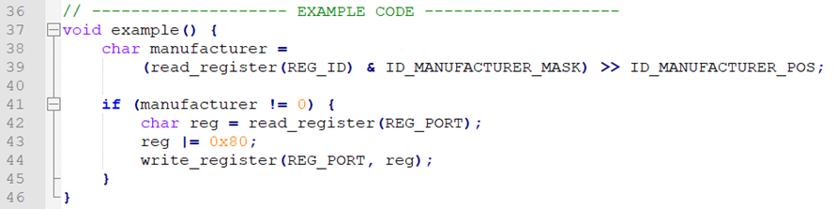
Possibilities in Rust
Much more is possible:

Slide 31
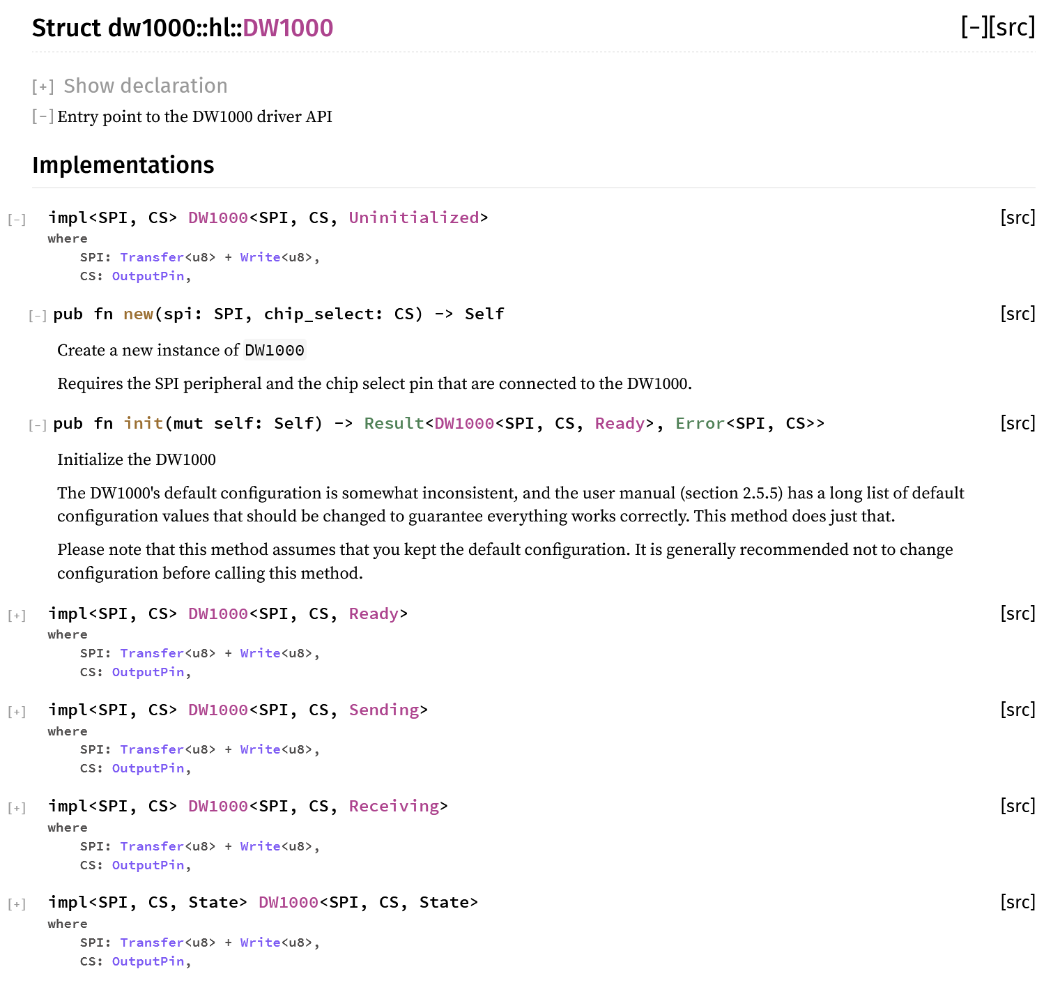
Possibilities in Rust
Add typestate to high level driver

Slide 32
Possibilities in Rust
Much more is possible:
Embedded-hal
Radio
Embedded-nal
Usb-device
Embedded-graphics
Accelerometer
Embedded-storage

Slide 33
Questions so far?
?

Slide 34
Exercise 2
A real driver for the LIS3DH
Open the book and read the intructions

Slide 35
Solution
How did you solve it?
What were the problems you encountered?
What did you like or dislike?

Slide 36

Castellastraat 26, 6512 EX Nijmegen
info@tweedegolf.com
024 3010 484

